Slide 1

Multi Agentic Workflow for student Attendance Recognition and Real-time Monitoring LMS
By
2311CS040044
2311CS040049
2311CS040050
D Sai Charan Reddy
E Shiva Shankar Reddy
E Vivek Reddy
Under the Guidance of
(Assistant Professor)
Department of Cyber Security
School of Engineering
Malla Reddy University
Hyderabad, Telangana, INDIA

Slide 2
ABSTRACT
Multi Agentic Workflow for student Attendance Recognition and Real-time Monitoring LMS is an AI-powered classroom monitoring and engagement analysis system designed to enhance the effectiveness of online learning environments using real-time computer vision and multi-agent intelligence. The system goes beyond traditional attendance tracking by continuously analyzing student presence, attentiveness, and identity during live virtual sessions. Using facial detection, facial landmark analysis, and head-pose estimation, Multi Agentic Workflow for student Attendance Recognition and Real-time Monitoring LMS verifies whether enrolled students remain present and actively engaged throughout a class. Independent AI agents collaboratively monitor attendance, detect signs of disengagement, and identify potential proxy attendance or identity changes, thereby supporting academic integrity. Built using technologies such as OpenCV, MediaPipe, Python, and modern web frameworks, the system operates on top of existing video-conferencing platforms without requiring complex infrastructure modifications. Multi Agentic Workflow for student Attendance Recognition and Real-time Monitoring LMS provides educators with meaningful insights into student participation while maintaining a human-in-the-loop approach to minimize bias, false positives, and privacy concerns.

Slide 3
1. Introduction
1.1 Problem Definition
Current online learning platforms can record student attendance but cannot accurately determine whether a student is genuinely present, attentive, or being represented by someone else throughout a live session. This lack of continuous monitoring can result in low engagement, proxy attendance, identity changes, and reduced academic integrity. Therefore, there is a need for an intelligent system that can automatically verify student presence, analyze engagement levels, and detect identity changes during online classes using Computer Vision and Multi-Agent AI techniques.
Description
Multi Agentic Workflow for student Attendance Recognition and Real-time Monitoring LMS is an AI-powered online classroom monitoring system that combines Computer Vision and Multi-Agent Intelligence to improve attendance and engagement monitoring. It analyzes live video streams using facial detection, facial landmarks, and head-pose/attention analysis to verify student presence and attentiveness. Independent agents monitor attendance, engagement, and identity integrity, while detected information is stored and presented to educators through reports and analytics. The system aims to create a more interactive, secure, and accountable online learning environment while supporting academic integrity.

Slide 4
1. Introduction
1.2 Objectives of the Project
Automate Attendance Verification: To automatically verify student attendance and ensure that the enrolled student remains present throughout the live online session.
Monitor Student Engagement: To analyze facial expressions, head movements, and attention levels in real time and identify signs of student disengagement.
Detect Proxy Attendance & Identity Changes: To continuously verify student identity and detect possible identity changes or proxy attendance during live classes, supporting academic integrity.
Implement Multi-Agent Intelligence: To use independent Attendance, Engagement, and Integrity Agents that work together to intelligently monitor student participation.
Provide Real-Time Insights: To provide teachers with meaningful attendance statistics, engagement analytics, alerts, and participation insights while maintaining a fair, ethical, and privacy-conscious approach.

Slide 5
2. System Analysis
2.1 Existing System
Background & Literature Survey
Existing online learning and video-conferencing platforms provide features such as virtual classes, communication, and basic attendance tracking. However, attendance alone does not ensure that a student remains genuinely present and attentive throughout the session. Current systems have limited capability to continuously analyze student presence, engagement, and identity in real time. Multi Agentic Workflow for student Attendance Recognition and Real-time Monitoring LMS addresses this gap by applying Computer Vision and Multi-Agent AI for intelligent monitoring during online classes.
Limitations of Existing System
Basic Attendance Tracking: Existing platforms may record attendance but cannot accurately verify whether the student remains present throughout the entire session.
Limited Engagement Monitoring: They cannot effectively determine student attentiveness using facial orientation, head movements, and attention levels.
Proxy Attendance: Existing attendance mechanisms may not detect when another person represents the registered student during an online class.
Lack of Continuous Identity Verification: Student identity is generally not continuously verified throughout a live session, making identity changes difficult to detect.
Limited Real-Time Insights: Educators lack detailed real-time information about student participation and engagement during online classes.

Slide 6
2. System Analysis
2.2 Proposed System
Multi Agentic Workflow for student Attendance Recognition and Real-time Monitoring LMS is an AI-powered online classroom monitoring system that combines Computer Vision and Multi-Agent Intelligence to improve attendance and student engagement. It continuously analyzes live video to verify student presence, monitor attentiveness, and identify possible identity changes during online classes.
Advantages of Proposed System
Automated Attendance: Continuously verifies student presence during live sessions.
Engagement Monitoring: Analyzes facial orientation, eye focus, and head pose to measure attentiveness.
Academic Integrity: Detects possible proxy attendance and identity changes.
Multi-Agent Intelligence: Attendance, Engagement, and Integrity Agents work together for intelligent monitoring.
Real-Time Insights: Provides teachers with attendance statistics, engagement analytics, and alerts.

Slide 7
2. System Analysis
2.3 Software & Hardware Requirements
Software Requirements
Python: Core programming language for AI and computer vision processing.
OpenCV: Processes live video feeds and supports face detection.
MediaPipe: Detects facial landmarks and tracks head movements.
WebRTC / SDK: Provides real-time video conferencing functionality.
SQLite / Firebase: Stores user details, attendance, engagement reports, and alerts.
Hardware Requirements
Computer/Laptop for accessing and running the application.
Webcam for real-time student video capture.
Stable Internet Connection for online classroom sessions.
Processor & Memory capable of supporting real-time video analysis.

Slide 8
3. Architectural Design
3.1 Modules Design
Authentication Module
The Authentication Module verifies students and faculty members using login credentials and OTP/email verification. It ensures that only authorized users can access the online classroom and system resources.
Video Conferencing Module
This module provides the live virtual classroom environment using WebRTC or a video-conferencing SDK. It captures real-time video streams of students for further monitoring and analysis.
Computer Vision Module
The Computer Vision Module processes live video using OpenCV and MediaPipe. It detects faces, extracts facial landmarks, and tracks head movements to collect information about student presence and attention.
Attendance Agent Module
The Attendance Agent continuously checks whether the registered student remains visible during the session. It records attendance and identifies prolonged absence from the camera.
Engagement Agent Module
The Engagement Agent analyzes facial orientation, eye focus, and head pose to determine student attentiveness and identify possible disengagement.

Slide 9
3. Architectural Design
Integrity Agent Module
The Integrity Agent continuously verifies student identity and detects possible identity changes or proxy attendance, flagging suspicious activity for review.
Database Management Module
Stores user details, attendance records, engagement reports, session logs, and alerts using SQLite or Firebase.
Dashboard & Reporting Module
Provides teachers and administrators with attendance statistics, engagement analytics, integrity alerts, and performance reports through an interactive dashboard.

Slide 10
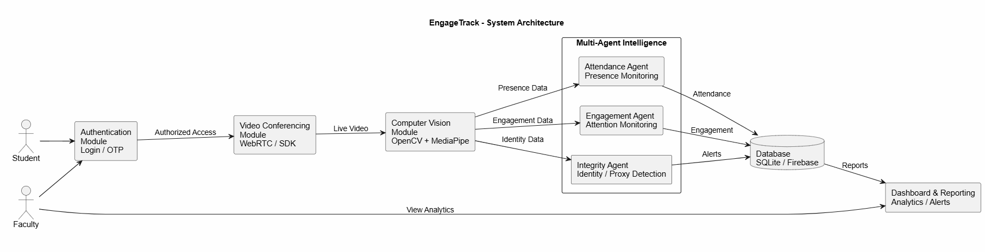
3. Architectural Design
3.3 Project Architecture
3.3.1 Architectural Diagram

Slide 11
Architectural Diagram:
Architectural diagram Description
Student/Faculty: Access the system and participate in live online classroom sessions.
Authentication: Verifies authorized students and faculty using login credentials and OTP/email verification.
Video Conferencing: Provides the live classroom and captures real-time video streams.
Computer Vision: Uses OpenCV and MediaPipe to detect faces, facial landmarks, and head movements.
Multi-Agent System: Attendance Agent monitors presence, Engagement Agent analyzes attentiveness, and Integrity Agent detects identity changes or proxy attendance.
Database & Dashboard: Monitoring information is stored securely and displayed to teachers as attendance statistics, engagement analytics, reports, and integrity alerts.

Slide 12
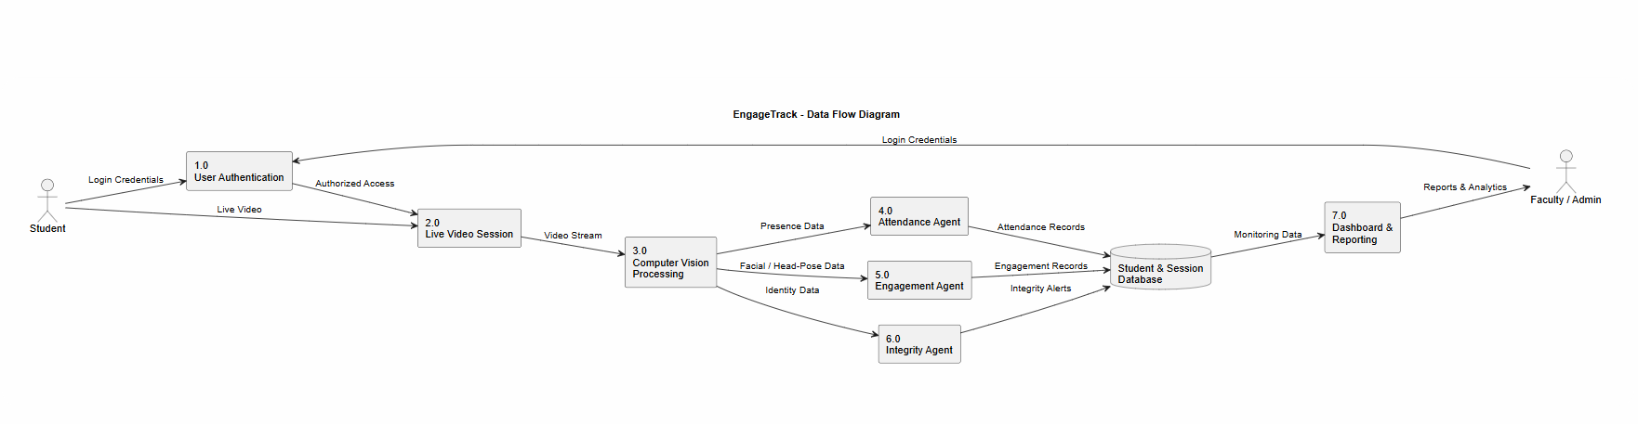
3. Architectural Design
3.3 Project Architecture
3.3.2 Data Flow Diagram

Slide 13
Data Flow Diagram:
User Authentication: Students and faculty log in, and the system verifies their credentials before granting access to the online classroom.
Live Session: The Video Conferencing Module provides the virtual classroom and captures the student's live video stream.
Computer Vision Processing: OpenCV and MediaPipe process the video to detect faces, facial landmarks, and head movements.
Attendance Monitoring: The Attendance Agent analyzes presence data and records attendance or prolonged absence.
Engagement Monitoring: The Engagement Agent analyzes facial orientation, eye focus, and head pose to identify attentiveness or disengagement.
Integrity Monitoring: The Integrity Agent verifies student identity and flags possible identity changes or proxy attendance.
Data Storage: Attendance records, engagement reports, session logs, and integrity alerts are stored in the database.
Dashboard & Reporting: Teachers and administrators receive attendance statistics, engagement analytics, reports, and integrity alerts.

Slide 14
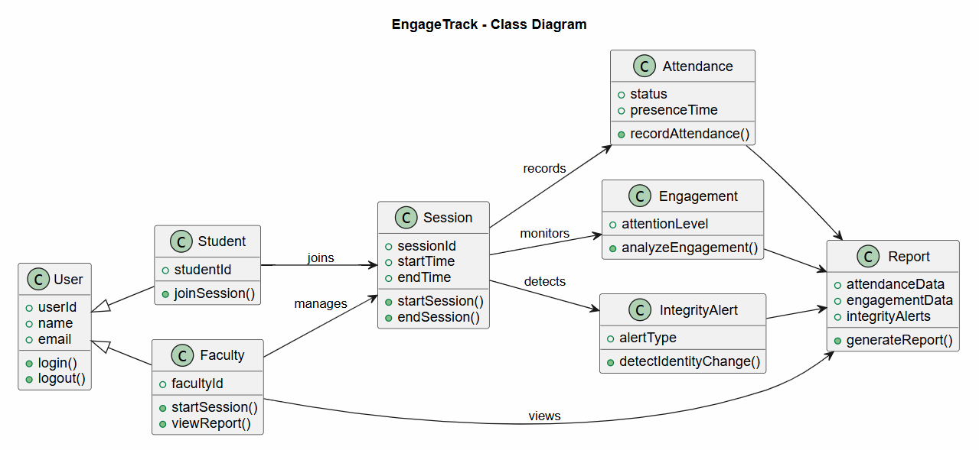
3. Architectural Design
3.3 Project Architecture
3.3.3 Class Diagram

Slide 15
Class Diagram:
User Class: Represents all users and manages common information such as user ID, name, email, login, and logout.
Student Class: Represents students who join live sessions and whose attendance, engagement, and identity are monitored.
Faculty Class: Represents teachers who manage sessions and view attendance, engagement reports, and integrity alerts.
Session Class: Manages live online classroom sessions and connects students with the monitoring process.
Attendance Class: Records student presence and identifies prolonged absence during a session.
Engagement Class: Stores attention information based on facial orientation, eye focus, and head pose.
Integrity Alert Class: Records suspicious activities such as identity changes and proxy attendance.
Report Class: Combines attendance, engagement, and integrity data and provides reports to faculty.

Slide 16
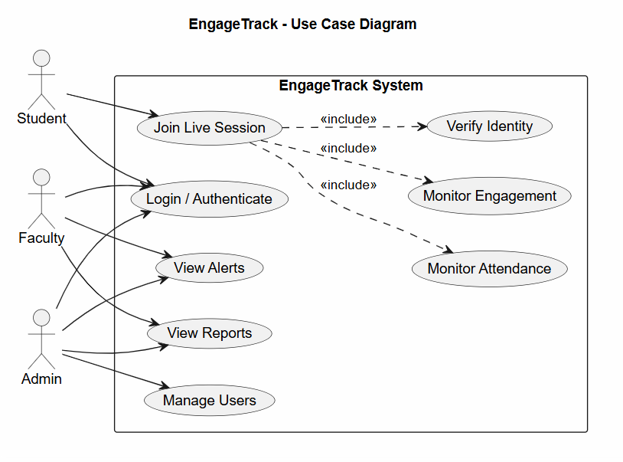
3. Architectural Design
3.3 Project Architecture
3.3.4 Use Case Diagram

Slide 17
Use Case Diagram:
Student: The student logs into Multi Agentic Workflow for student Attendance Recognition and Real-time Monitoring LMS using authorized credentials and joins the live online classroom. During the session, the system automatically monitors the student's presence, attentiveness, and identity.
Faculty: The faculty member accesses the system to conduct or monitor online sessions. They can use the dashboard to view attendance statistics, engagement analytics, integrity alerts, and participation reports.
Login & Authentication: Verifies students and faculty using login credentials and OTP/email verification before providing access to the system.
Join Online Class: Allows authenticated students to participate in the live virtual classroom, where the video stream is captured for real-time monitoring.
Presence Verification: The Attendance Agent continuously checks whether the registered student remains visible and identifies prolonged absence from the camera.
Engagement Analysis: The Engagement Agent analyzes facial orientation, eye focus, and head pose to determine attentiveness and identify possible disengagement.
Identity Verification: The Integrity Agent verifies student identity throughout the session and detects possible identity changes or proxy attendance.
Alerts & Reports: Monitoring results are stored and presented through the dashboard. Faculty can review attendance records, engagement analytics, and integrity alerts to understand student participation.

Slide 18
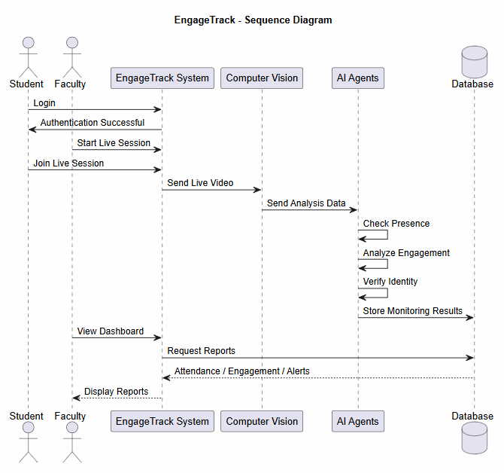
3. Architectural Design
3.3 Project Architecture
3.3.5 Sequence Diagram

Slide 19
Sequence Diagram:
Login: Student and faculty authenticate before accessing the Multi Agentic Workflow for student Attendance Recognition and Real-time Monitoring LMS system.
Live Session: Faculty starts the online session and the student joins the virtual classroom.
Video Analysis: The live video stream is processed using computer vision to obtain facial and head-movement information.
AI Monitoring: Attendance, Engagement, and Integrity Agents analyze presence, attentiveness, and identity.
Data Storage: Attendance records, engagement information, session logs, and integrity alerts are stored in the database.
Dashboard: Faculty accesses the dashboard to view attendance, engagement analytics, reports, and alerts.

Slide 20
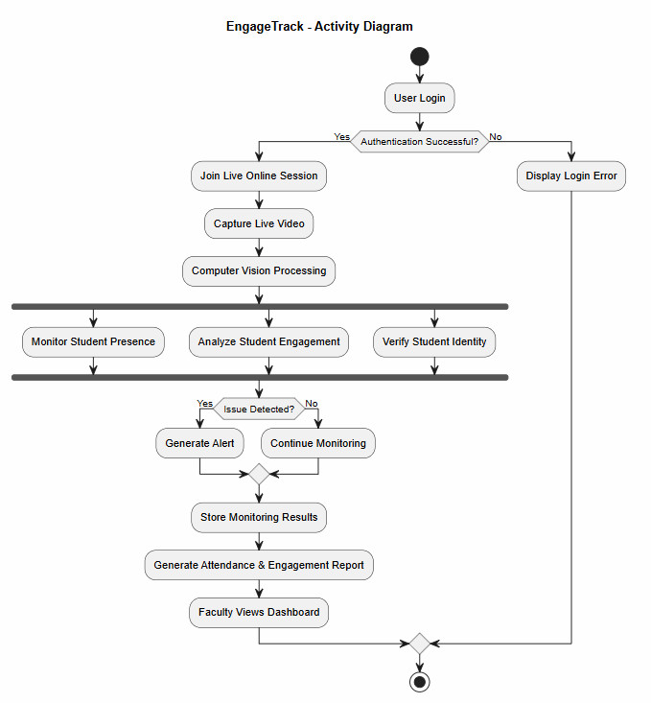
3. Architectural Design
3.3 Project Architecture
3.3.6 Activity Diagram

Slide 21
Activity Diagram:
User Authentication: Students and faculty log in and their credentials are verified before accessing the system.
Live Session: The authenticated student joins the online classroom and the system captures the live video stream.
Computer Vision Processing: OpenCV and MediaPipe process the video to obtain facial and head-movement information.
Multi-Agent Monitoring: Attendance, Engagement, and Integrity Agents monitor student presence, attentiveness, and identity during the session.
Alert Generation: Possible disengagement, prolonged absence, identity changes, or proxy attendance are identified and flagged for review.
Reporting: Monitoring results are stored and presented to faculty through attendance statistics, engagement analytics, and integrity alerts.

Slide 22
Technologies
1. Backend Technologies
Python: The core programming language used to implement computer vision processing and the multi-agent monitoring functionality.
OpenCV: Used for processing real-time video feeds, face detection, and visual analysis during online classroom sessions.
MediaPipe: Used for facial landmark detection, facial orientation, eye-focus analysis, and head-movement tracking.
SQLite / Firebase: Used to store user details, attendance records, engagement reports, session logs, and integrity alerts.
WebRTC / SDK: Provides the live video-conferencing environment and real-time video streams required for student monitoring.
2. Frontend Technologies
HTML5: Used to structure the web-based interface of Multi Agentic Workflow for student Attendance Recognition and Real-time Monitoring LMS.
CSS3: Used to design a responsive and user-friendly interface.
JavaScript: Used to provide dynamic interactions and real-time updates on the dashboard.

Slide 23
4. Implementation and Testing
4.1 Coding Blocks
Main.py
import sys, os
sys.path.append(os.path.dirname(os.path.abspath(__file__)))
sys.path.append(os.path.abspath(os.path.join(os.path.dirname(__file__), '..')))
from fastapi import FastAPI
from fastapi.middleware.cors import CORSMiddleware
from routers import auth, admin, classroom, academic, assignments, chat, export, notifications, wall
app = FastAPI(title="EngageAI Core API", version="1.0.0")
app.add_middleware(
CORSMiddleware,
allow_origins=["*"],
allow_credentials=True,
allow_methods=["*"],
allow_headers=["*"],
)
app.include_router(auth.router, prefix="/api")
app.include_router(admin.router, prefix="/api")
app.include_router(classroom.router, prefix="/api")
app.include_router(academic.router, prefix="/api/academic")
app.include_router(assignments.router, prefix="/api")
app.include_router(export.router, prefix="/api")
app.include_router(notifications.router, prefix="/api")
app.include_router(wall.router, prefix="/api")
app.include_router(chat.router, prefix="/api")
from routers import meet_ws
app.include_router(meet_ws.router, prefix="/api/meet")
@app.get("/")
def root():
return {"message": "Welcome to EngageAI Core API"}

Slide 24
Migrate_users.py
import sys
import os
sys.path.append(os.path.dirname(os.path.dirname(os.path.abspath(__file__))))
import sqlite3
import datetime
from database import SessionLocal
from shared.models import User
# Connect to sqlite
sqlite_conn = sqlite3.connect('lms.db')
cursor = sqlite_conn.cursor()
cursor.execute("SELECT id, email, hashed_password, full_name, role, department, roll_number, is_approved, reset_token, created_at FROM users")
rows = cursor.fetchall()
# Connect to postgres
db = SessionLocal()
user = User(
id=row[0],
email=row[1],
hashed_password=row[2],
full_name=row[3],
role=row[4],
department=row[5],
roll_number=row[6],
is_approved=bool(row[7]),
reset_token=row[8],
created_at=created_at
)
db.add(user)
except Exception as e:
print(f"Error copying {row[1]}: {e}")
db.commit()
print(f"Copied {len(rows)} users from SQLite to Supabase!")
db.close()
sqlite_conn.close()
for row in rows:
try:
if type(row[9]) == str:
try:
created_at = datetime.datetime.strptime(row[9], "%Y-%m-%d %H:%M:%S.%f")
except:
created_at = datetime.datetime.utcnow()
else:
created_at = row[9] or datetime.datetime.utcnow()

Slide 25
Test_acsses.py
Test_acsess_active.py
import urllib.request, json
users = ['admin@ssvuniversity.in', 'rajesh.kumar@ssvuniversity.in', '26cs001@ssvuniversity.in']
for u in users:
try:
req = urllib.request.Request('http://127.0.0.1:8000/api/auth/login', data=json.dumps({'email': u, 'password': '123456'}).encode(), headers={'Content-Type': 'application/json'})
token = json.loads(urllib.request.urlopen(req).read().decode())['access_token']
req2 = urllib.request.Request('http://127.0.0.1:8000/api/academic/meets/ENGAGE-MEET-066DFA99/join-check', headers={'Authorization': f'Bearer {token}'})
res = json.loads(urllib.request.urlopen(req2).read().decode())
print(f"[{u}] Status: {res.get('status')} | Message: {res.get('message')}")
except urllib.error.HTTPError as e:
print(f"[{u}] HTTP {e.code}: {e.read().decode()}")
except Exception as e:
print(f"[{u}] Error: {e}")
import urllib.request, json, sys
u = 'rajesh.kumar@ssvuniversity.in'
req = urllib.request.Request('http://127.0.0.1:8000/api/auth/login', data=json.dumps({'email': u, 'password': '123456'}).encode(), headers={'Content-Type': 'application/json'})
token = json.loads(urllib.request.urlopen(req).read().decode())['access_token']
req2 = urllib.request.Request('http://127.0.0.1:8000/api/academic/meets/MEET-TEST-FACULTY-1/join-check', headers={'Authorization': f'Bearer {token}'})
res = json.loads(urllib.request.urlopen(req2).read().decode())
output = f"Faculty Check Status: {res.get('status')} | Message: {res.get('message')}\n"
sys.stdout.buffer.write(output.encode('utf-8', errors='replace'))

Slide 26
Index.css
/* Glow buttons */
.glow-btn {
@apply font-semibold rounded-xl px-6 py-3 transition-all duration-300 bg-brand-600 hover:bg-brand-500 text-white relative overflow-hidden;
box-shadow: 0 4px 14px 0 rgba(59, 130, 246, 0.4);
}
.glow-btn:hover {
box-shadow: 0 6px 20px 0 rgba(59, 130, 246, 0.6);
transform: translateY(-1px);
}
.glow-btn-secondary {
background: rgba(255, 255, 255, 0.05);
border: 1px solid rgba(255, 255, 255, 0.1);
@apply font-semibold rounded-xl px-6 py-3 transition-all duration-300 hover:bg-white/10 text-slate-100 outline-none;
}
@import url('https://fonts.googleapis.com/css2?family=Outfit:wght@300;400;500;600;700&display=swap');
@tailwind base;
@tailwind components;
@tailwind utilities;
@layer base {
body {
font-family: 'Outfit', sans-serif;
@apply bg-slate-950 text-slate-100 overflow-x-hidden;
background-image: radial-gradient(circle at 50% 0%, rgba(30, 58, 138, 0.25) 0%, transparent 50%),
radial-gradient(circle at 100% 100%, rgba(99, 102, 241, 0.1) 0%, transparent 40%);
}
}
/* Text glow */
.text-glow {
text-shadow: 0 0 12px rgba(59, 130, 246, 0.5);
}
/* Custom scrollbars */
::-webkit-scrollbar {
width: 6px;
height: 6px;
}
::-webkit-scrollbar-track {
background: rgba(15, 23, 42, 0.5);
}
::-webkit-scrollbar-thumb {
background: rgba(255, 255, 255, 0.1);
border-radius: 9999px;
}
::-webkit-scrollbar-thumb:hover {
background: rgba(255, 255, 255, 0.2);
}
/* Glassmorphism Styles */
.glass-card {
background: rgba(15, 23, 42, 0.55);
backdrop-filter: blur(16px);
-webkit-backdrop-filter: blur(16px);
border: 1px solid rgba(255, 255, 255, 0.08);
box-shadow: 0 8px 32px 0 rgba(0, 0, 0, 0.37);
@apply rounded-2xl transition-all duration-300;
}
.glass-card-hover:hover {
background: rgba(15, 23, 42, 0.65);
border-color: rgba(255, 255, 255, 0.15);
box-shadow: 0 8px 32px 0 rgba(99, 102, 241, 0.15);
}

Slide 27
4. Implementation and Testing
4.2 Sample Code
Main.jsx
App.jsx
import React from 'react'
import ReactDOM from 'react-dom/client'
import App from './App.jsx'
import './index.css'
import ErrorBoundary from './components/ErrorBoundary.jsx'
ReactDOM.createRoot(document.getElementById('root')).render(
<React.StrictMode>
<ErrorBoundary>
<App />
</ErrorBoundary>
</React.StrictMode>,
)
import React from 'react';
import { BrowserRouter, Routes, Route, Navigate } from 'react-router-dom';
import { AuthProvider, useAuth } from './hooks/useAuth';
import Login from './pages/Login';
import Register from './pages/Register';
import ResetPassword from './pages/ResetPassword';
import StudentDashboard from './pages/StudentDashboard';
import TeacherDashboard from './pages/TeacherDashboard';
import AdminDashboard from './pages/AdminDashboard';
import DeptAdminDashboard from './pages/DeptAdminDashboard';
import { Loader2 } from 'lucide-react';
import { BrandingProvider } from './hooks/useBranding';
import ErrorBoundary from './components/ErrorBoundary';
const ProtectedRoute = ({ children, allowedRoles }) => {
const { isAuthenticated, user, isLoading } = useAuth();
if (isLoading) {
return (
<div className="min-h-screen flex items-center justify-center bg-slate-950">
<Loader2 className="h-10 w-10 animate-spin text-brand-500" />
</div>
);
}

Slide 28
if (!isAuthenticated || !user) {
return <Navigate to="/login" replace />;
}
if (allowedRoles && !allowedRoles.includes(user.role)) {
// Redirect to matching role dashboard if they try to access wrong panel
if (user.role === 'admin') return <Navigate to="/admin" replace />;
if (user.role === 'dept_admin') return <Navigate to="/dept-admin" replace />;
if (user.role === 'teacher') return <Navigate to="/teacher" replace />;
return <Navigate to="/student" replace />;
}
return children;
};
<Route
path="/dept-admin"
element={
<ProtectedRoute allowedRoles={['dept_admin']}>
<DeptAdminDashboard />
</ProtectedRoute>
}
/>
<Route path="*" element={<Navigate to="/login" replace />} />
</Routes>
<HelpChatbot />
</BrowserRouter>
</BrandingProvider>
</AuthProvider>
);
}
import HelpChatbot from './components/HelpChatbot';
export default function App() {
return (
<AuthProvider>
<BrandingProvider>
<BrowserRouter>
<Routes>
<Route path="/login" element={<Login />} />
<Route path="/register" element={<Register />} />
<Route path="/reset-password" element={<ResetPassword />} />
<Route
path="/student"
element={
<ProtectedRoute allowedRoles={['student']}>

Slide 29
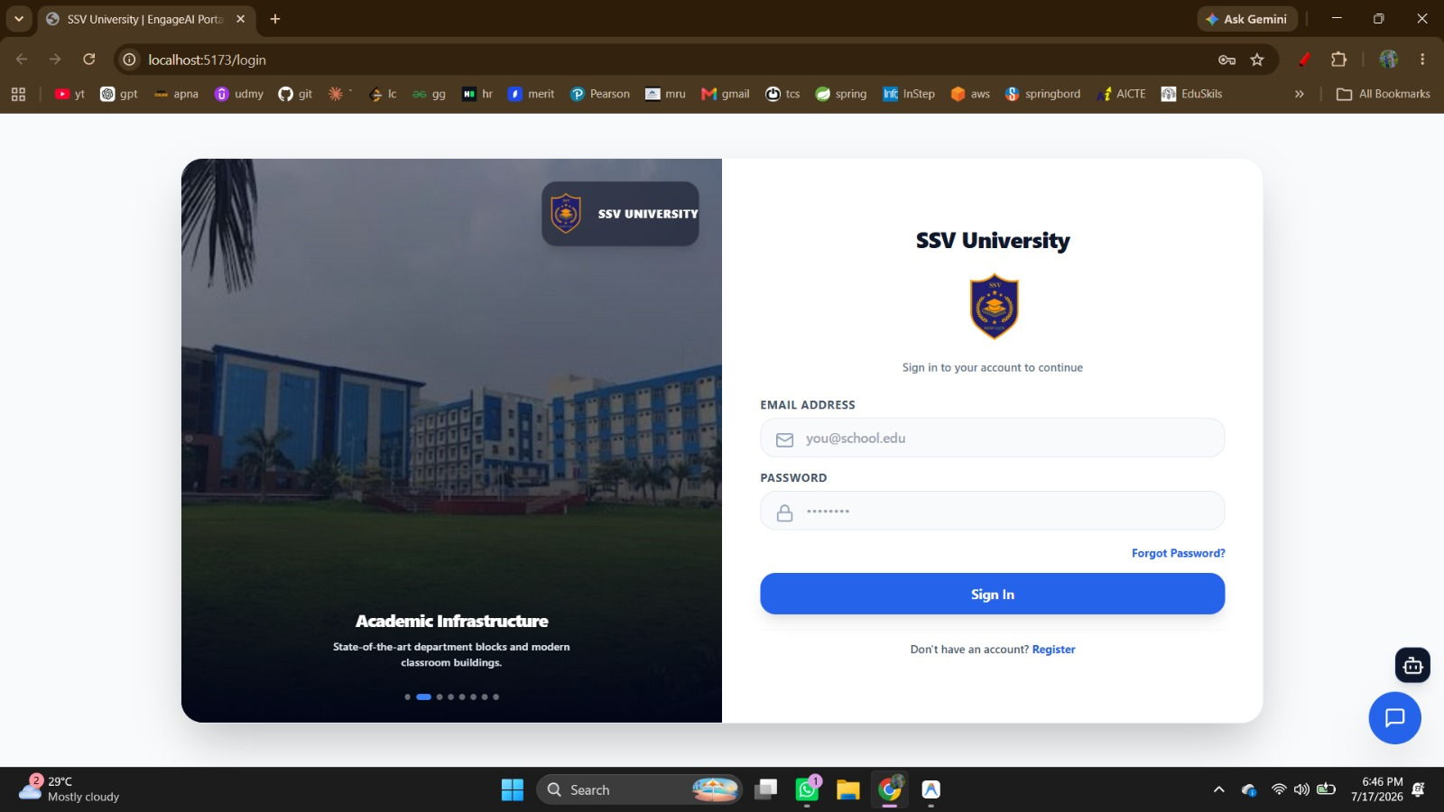
4. Implementation and Testing
4.3 Execution
The Main Login Page serves as the common entry point for all authorized users of the Multi Agentic Workflow for student Attendance Recognition and Real-time Monitoring LMS system, including Students, Faculty, Department Admins, and Main Admins. Users sign in using their registered email address and password, after which the system identifies their role and provides access to the appropriate dashboard and features.

Slide 30
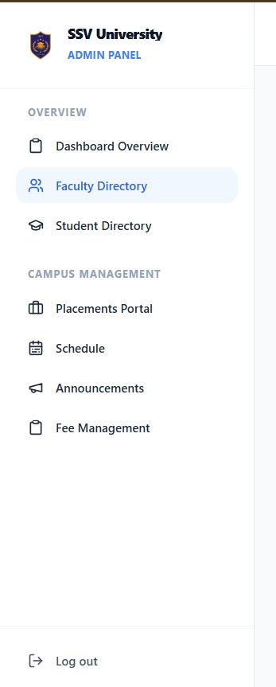
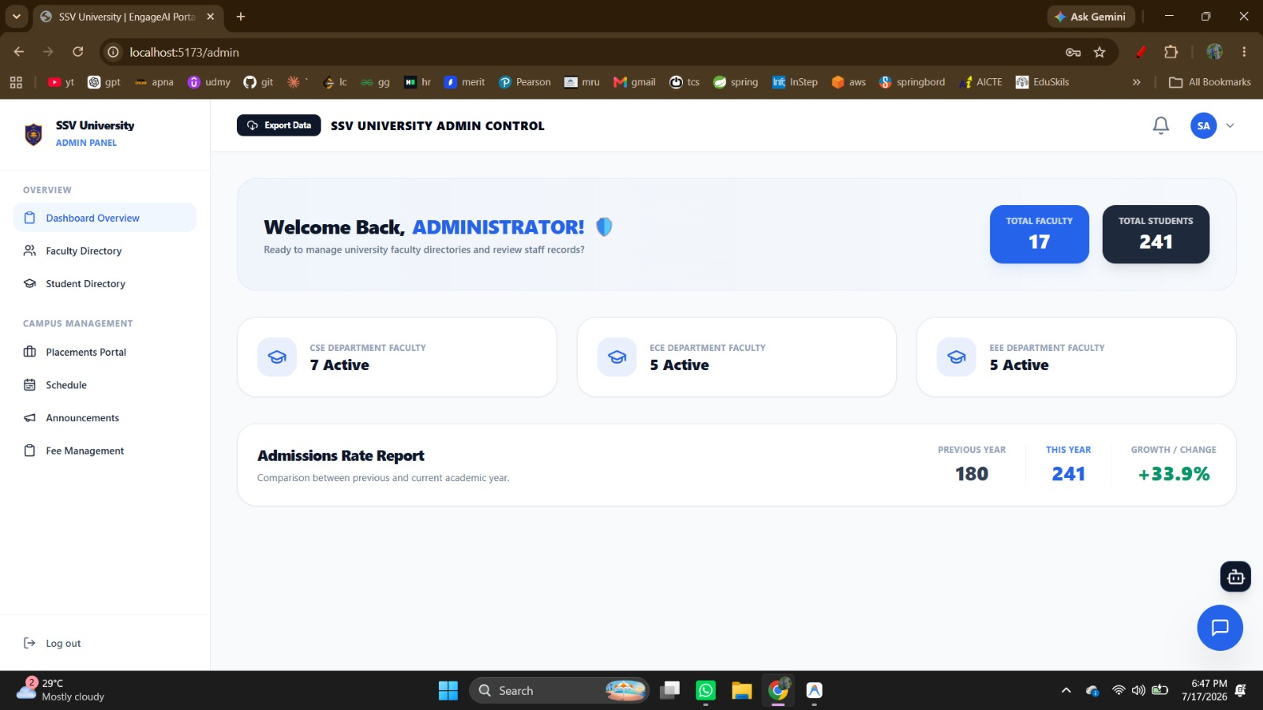
Admin Dashboard
The Admin Dashboard provides a centralized interface for managing and monitoring university-level activities within the system. It gives the administrator a quick overview of important information such as the total number of faculty and students, along with department-wise faculty statistics. The dashboard also provides access to key modules including the Faculty Directory, Student Directory, Placements Portal, Schedule, Announcements, and Fee Management. It displays an Admissions Rate Report comparing current and previous academic-year admissions, helping administrators track institutional growth. Overall, the dashboard enables efficient management of academic records, faculty and student information, and major campus activities from a single interface.

Slide 31
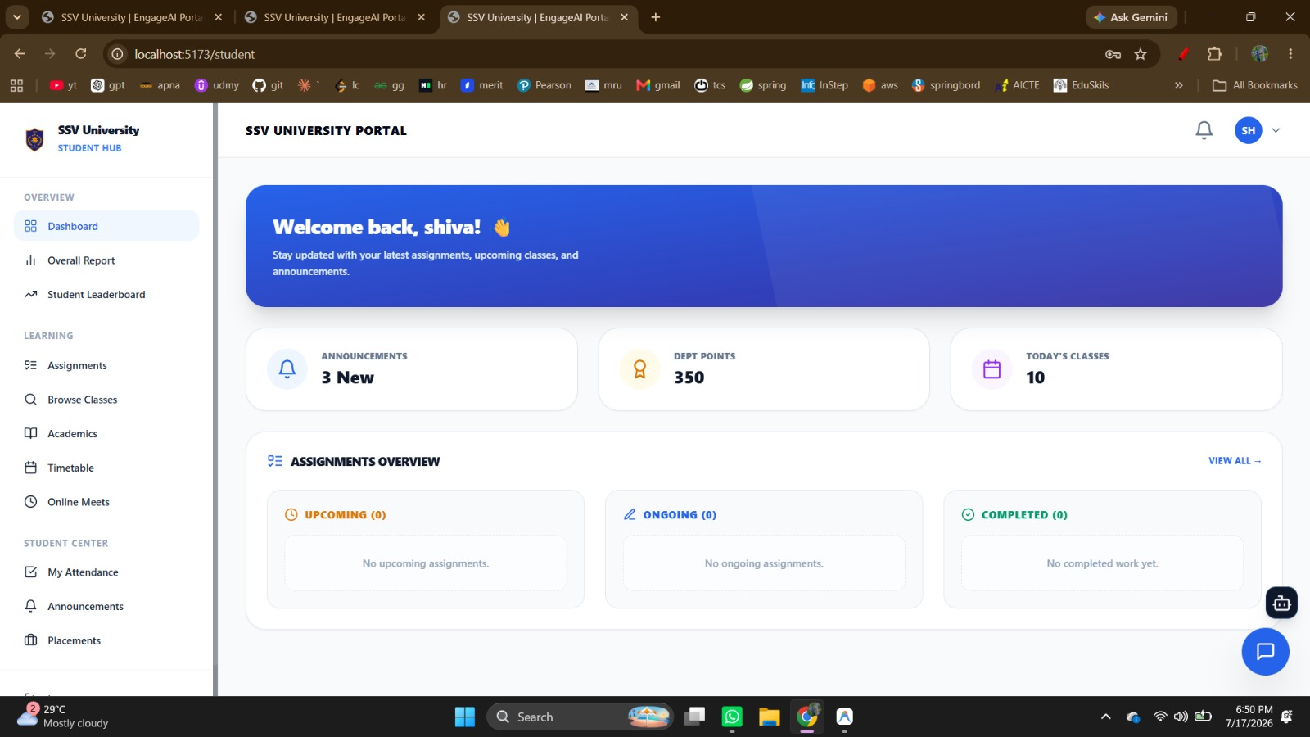
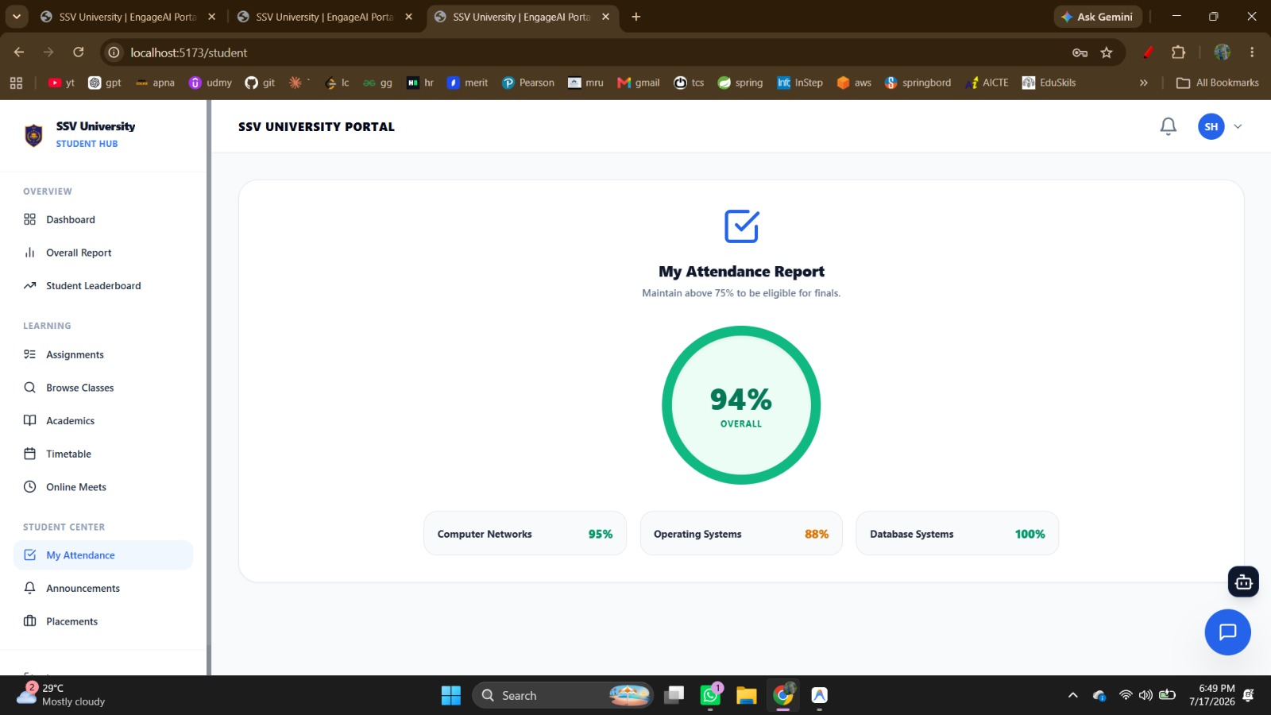
Student Dashboard
The Student Dashboard provides students with a centralized interface to access and manage their academic activities. It displays important information such as announcements, department points, today’s classes, and assignment status, allowing students to quickly view their current academic updates. Students can access features including Assignments, Browse Classes, Academics, Timetable, Online Meets, Attendance, Announcements, Placements, Overall Reports, and the Student Leaderboard. The assignment overview also organizes tasks into upcoming, ongoing, and completed categories. Overall, the dashboard acts as a personalized academic hub that helps students track classes, attendance, assignments, and other university activities from one place.

Slide 32
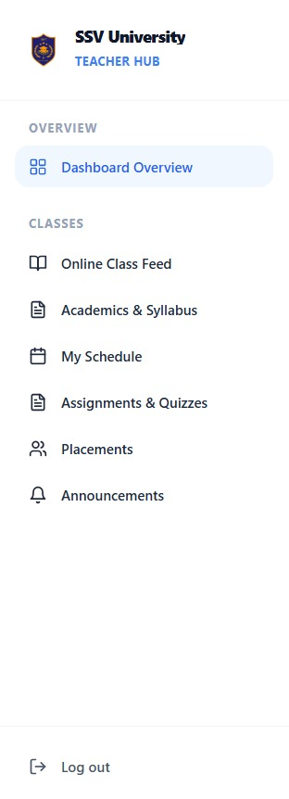
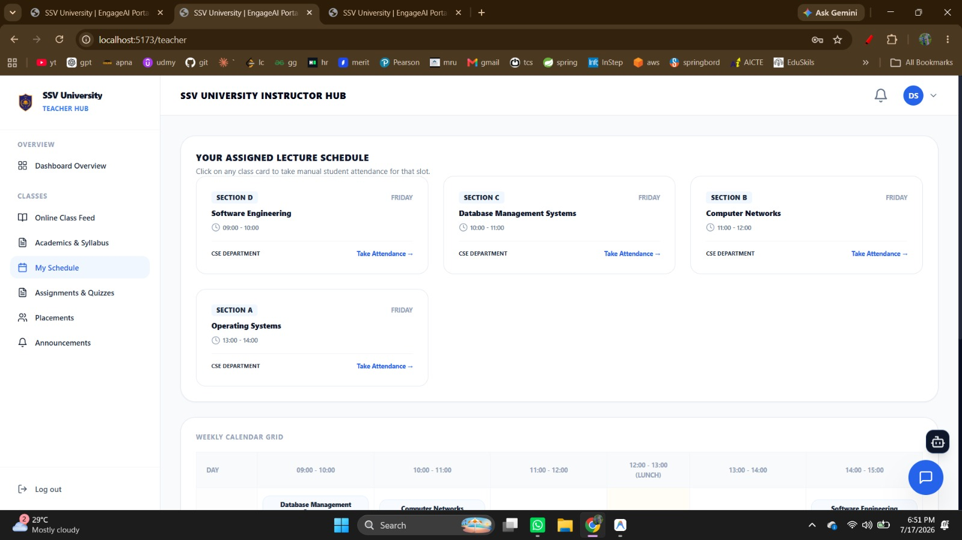
Faculty Dashboard
The Faculty Dashboard provides instructors with a centralized interface to manage their teaching schedules, classes, attendance, and academic activities. It displays the faculty member’s assigned lecture schedule with details such as subject, section, class timing, day, and department, allowing attendance to be accessed directly for each class. Faculty can also use modules such as Online Class Feed, Academics & Syllabus, My Schedule, Assignments & Quizzes, Placements, and Announcements. A weekly calendar view helps instructors organize their lectures efficiently. Overall, the dashboard simplifies classroom management and provides faculty with quick access to essential teaching and student-related activities.

Slide 33
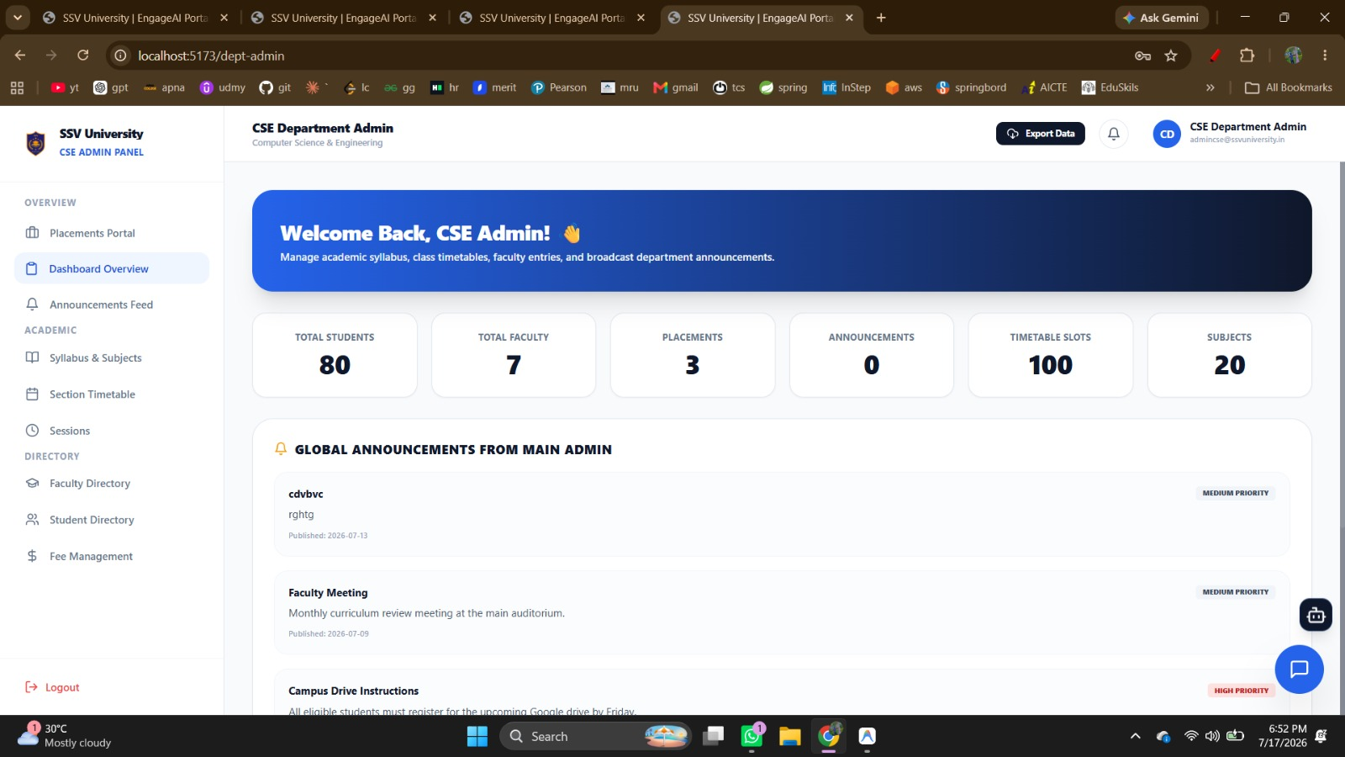
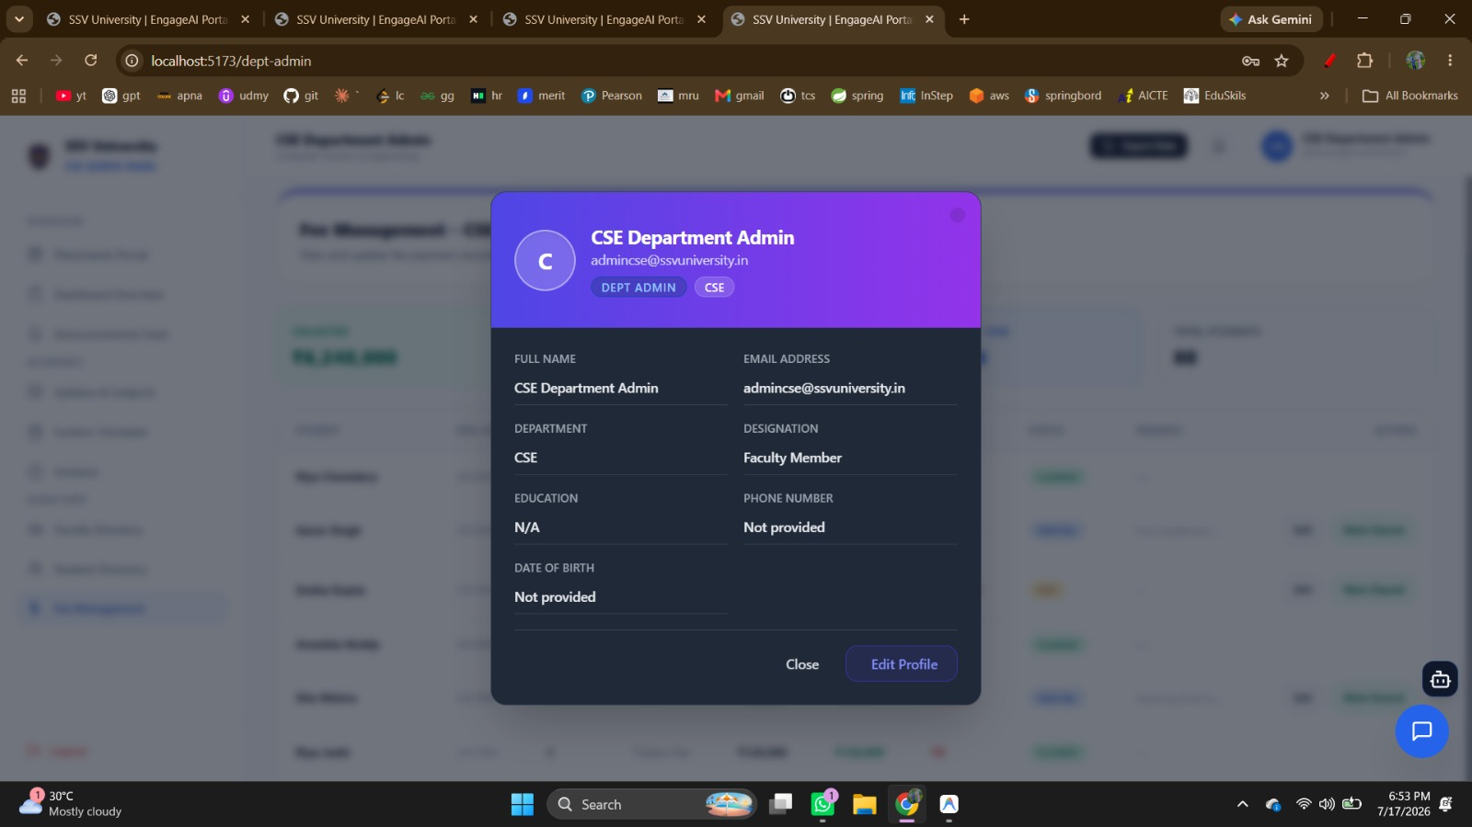
Department Admin Dashboard
The Department Admin Dashboard provides department-level administrators with a centralized platform to manage and monitor academic activities within their department. It displays key information such as total students, faculty members, placements, announcements, timetable slots, and subjects. The Department Admin can manage syllabus and subjects, section timetables, academic sessions, faculty and student directories, announcements, placements, and fee-related information. It also displays important global announcements from the Main Admin, helping maintain communication between university administration and individual departments. Overall, the dashboard supports efficient coordination and management of department-specific academic and administrative activities.

Slide 34
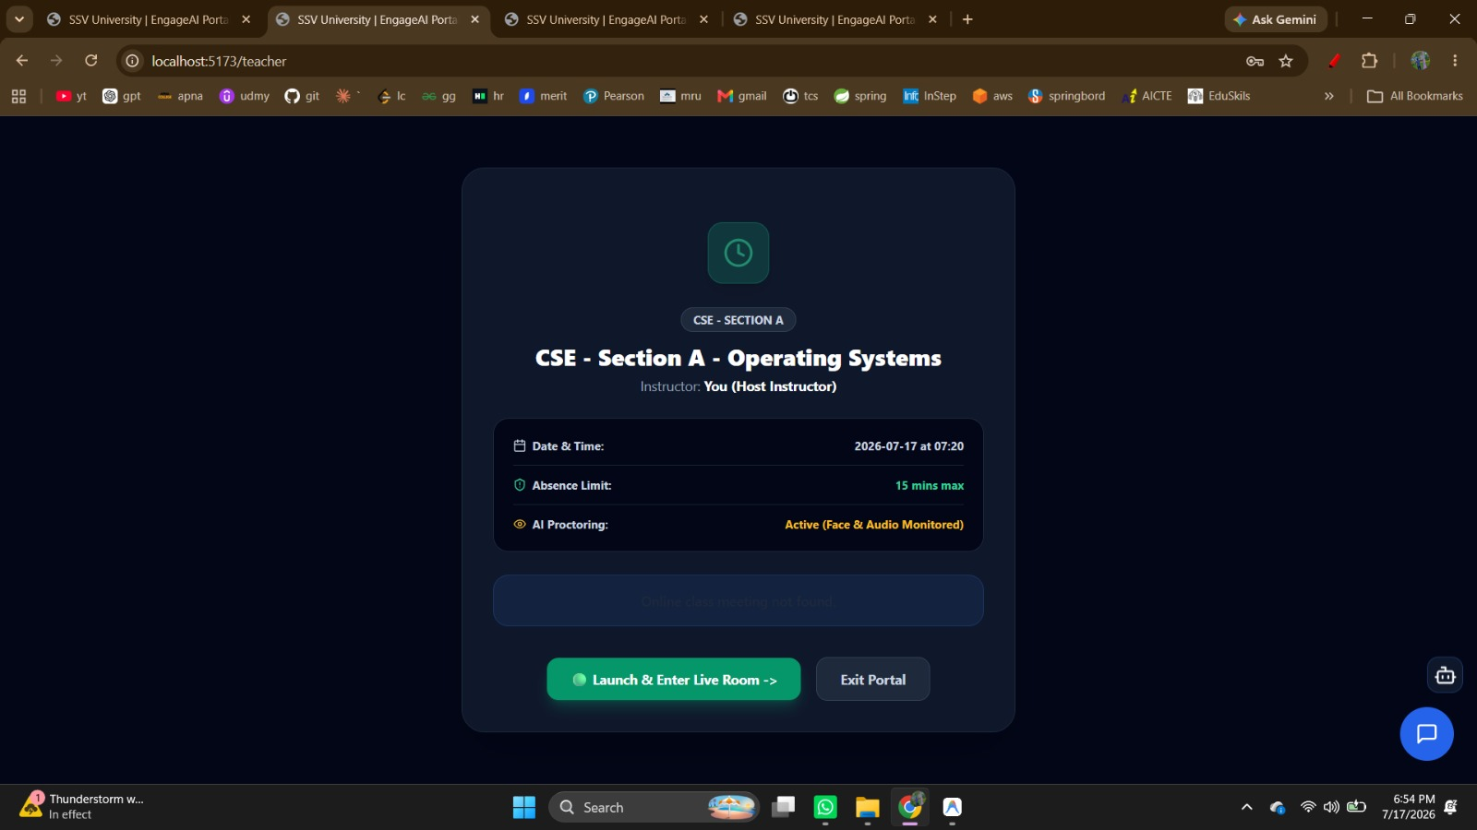
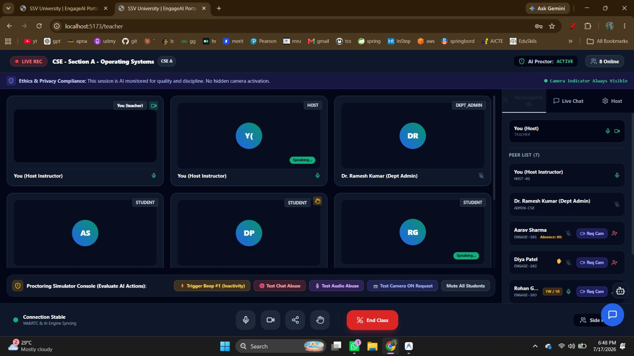
Online Video Conference/Meeting
The Video Conference Meeting module provides the live virtual classroom environment where faculty, students, and authorized department administrators can participate in online sessions. It supports essential meeting controls such as microphone, camera, participant management, live chat, screen sharing, and class termination. During the session, the AI Proctor operates alongside the meeting to monitor student presence, activity, and classroom behavior while keeping camera-monitoring status visible for transparency. Faculty can view online participants, manage student interactions, and receive monitoring indicators or alerts during the class. This module acts as the main real-time environment where Multi Agentic Workflow for student Attendance Recognition and Real-time Monitoring LMS’s attendance, engagement, and integrity monitoring capabilities are applied.

Slide 35
Thank You

